Slide 1
Hotel Revenue Analysis
Presented By:
Om Bokare
Rinisha Shajitha
Rinal Dave
Mihira Sri
Aditi Sahu
Alekhya
Rethiga

Slide 2
Introduction
The hospitality industry generates large amounts of data from reservations, customer interactions, and pricing strategies. However, converting this data into meaningful insights requires effective analytical tools.
Data analytics helps hotels understand booking trends, customer behavior, revenue patterns, and operational performance.
This project focuses on analyzing hotel booking data using Power BI, a business intelligence tool that enables interactive dashboards and data visualization.
By transforming raw data into dashboards, the project aims to help hotel management make data-driven decisions.

Slide 3
Problem Statement
Hotels often collect large amounts of booking data but face difficulties in extracting meaningful insights from it.
Without proper analysis:
Revenue performance cannot be tracked effectively.
Customer booking behaviour remains unclear.
Pricing strategies may not be optimized.
Operational patterns are difficult to analyze.
Therefore, there is a need to develop an analytical system that converts raw hotel booking data into actionable insights.

Slide 4
Project Objectives
The primary objectives of this project are:
To analyze hotel booking data using business intelligence techniques.
To identify patterns in customer booking behaviour.
To evaluate revenue performance and pricing strategies.
To understand operational trends within hotel management.
To develop interactive dashboards using Power BI that support decision-making.

Slide 5
Dataset Description
The dataset used in this project contains hotel booking information from multiple years.
It includes various attributes that describe customer reservations, hotel characteristics, and pricing details.
Some key attributes in the dataset include:
Arrival Date,Hotel Type,Market Segment,Distribution Channel, Customer Country
Average Daily Rate (ADR)
Stay Duration (Weekend and Weekday Nights)
Booking Status (Cancelled / Not Cancelled)
Customer Type
These attributes allow comprehensive analysis of customer behaviour and revenue patterns.

Slide 6
Data Preprocessing
Before building the dashboards, the dataset underwent several preprocessing steps to ensure accuracy.
The preprocessing steps included:
Data cleaning
Handling missing values
Removing duplicate entries
Data transformation
Creating calculated measures
These steps ensured that the dataset was reliable for further analysis and visualization.

Slide 7
Data Modeling
Data modeling is an important step in building analytical dashboards.
In this project, the data was structured to support efficient analysis.
The dataset was organized into:
A central table containing booking transactions
Supporting dimensions such as hotel type, market segment, and booking channels
This structured data model allowed Power BI to generate fast queries and accurate insights.

Slide 8
Tools and Technologies
The following tools and technologies were used in this project:
Microsoft Power BI Used for building interactive dashboards and data visualization.
Microsoft Excel Used for initial data handling and preprocessing.
Business Intelligence Techniques Applied to transform raw data into meaningful insights.
These tools helped convert complex booking data into easy-to-understand visual analytics.

Slide 9
Dashboard Architecture
To analyze the dataset effectively, four dashboards were created:
Executive Overview
Booking Behaviour Analysis
Revenue & Pricing Analysis
Operational Insights
Each dashboard focuses on a different aspect of hotel performance, providing a comprehensive analysis.

Slide 10
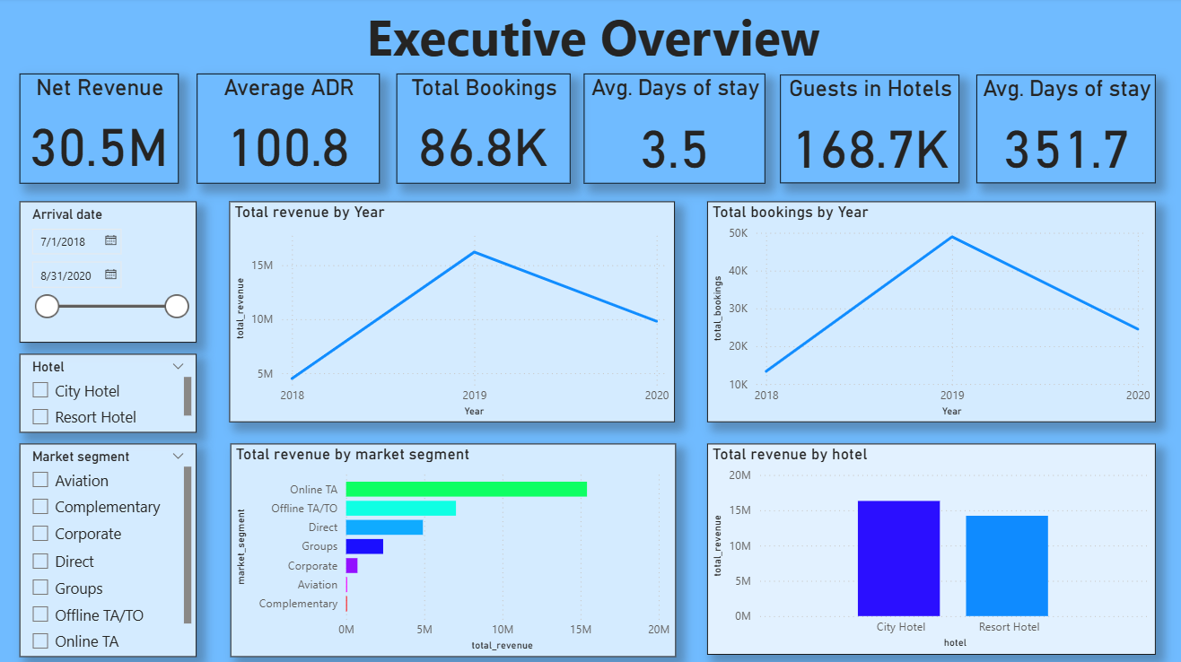
Dashboard 1: Executive Overview
Title: Executive Overview Dashboard
This dashboard provides a high-level summary of hotel performance.
Key performance indicators displayed include:
Total Revenue, Total Bookings , Average Daily Rate (ADR),Occupancy
Rate, Average Length of Stay.
Visualizations included in this dashboard:
Revenue Trend (Monthly)
Booking Trend
Revenue by Hotel Type
Revenue by Market Segment
This dashboard helps management quickly understand overall hotel
performance.

Slide 11
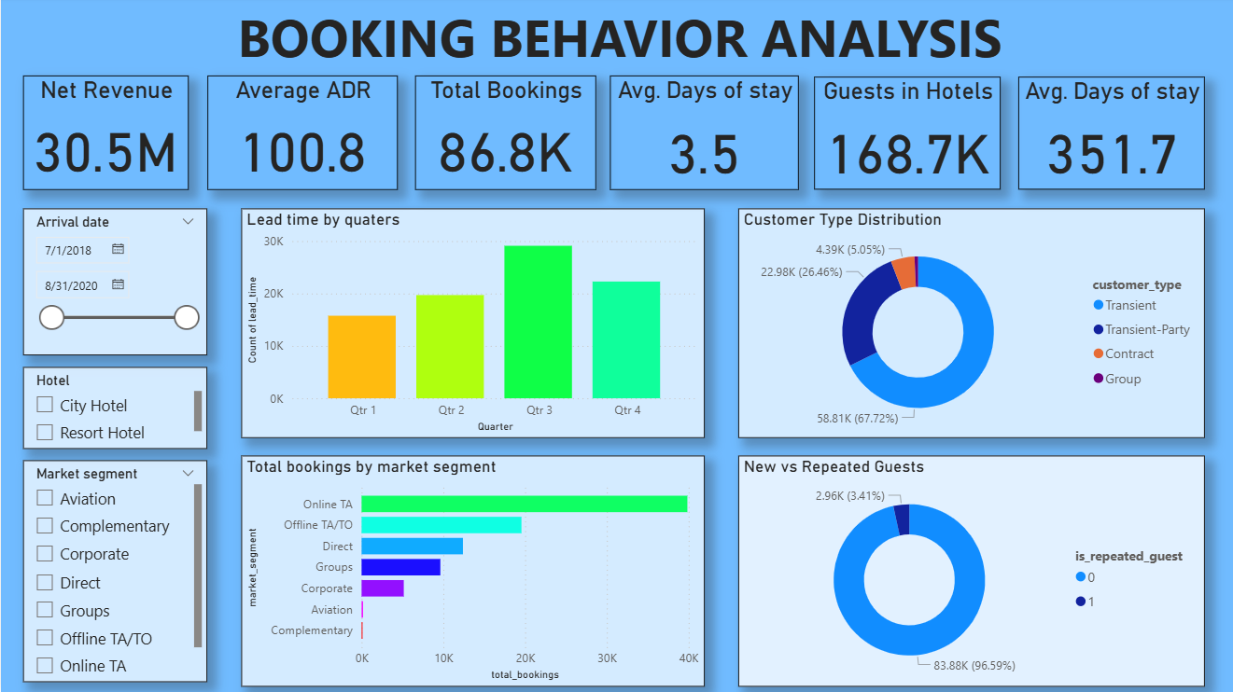
Dashboard 2: Booking Behavior Analysis
This dashboard focuses on understanding customer booking
patterns.
Visualizations included:
Lead Time Distribution
Booking by Customer Type
Booking Distribution by Channel
Cancellation Rate
Repeat vs New Guests
These insights help hotels understand how customers make
reservations and identify opportunities to improve customer
retention.

Slide 12
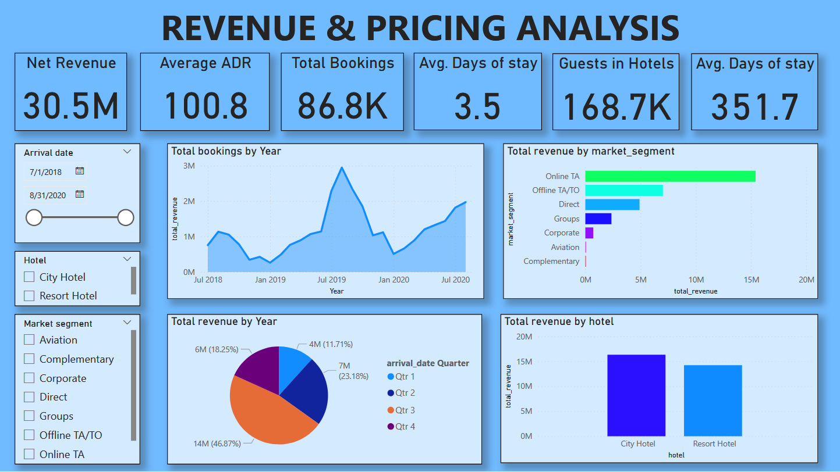
Dashboard 3: Revenue & Pricing Analysis
Title: Revenue & Pricing Analysis
This dashboard focuses on analyzing hotel pricing strategies
and revenue performance.
Key visualizations include:
ADR Trend
Revenue by Room Type
Revenue by Season
Revenue vs ADR (Scatter Plot)
Revenue per Booking KPI
This dashboard helps evaluate pricing effectiveness and identify
opportunities for revenue optimization.

Slide 13
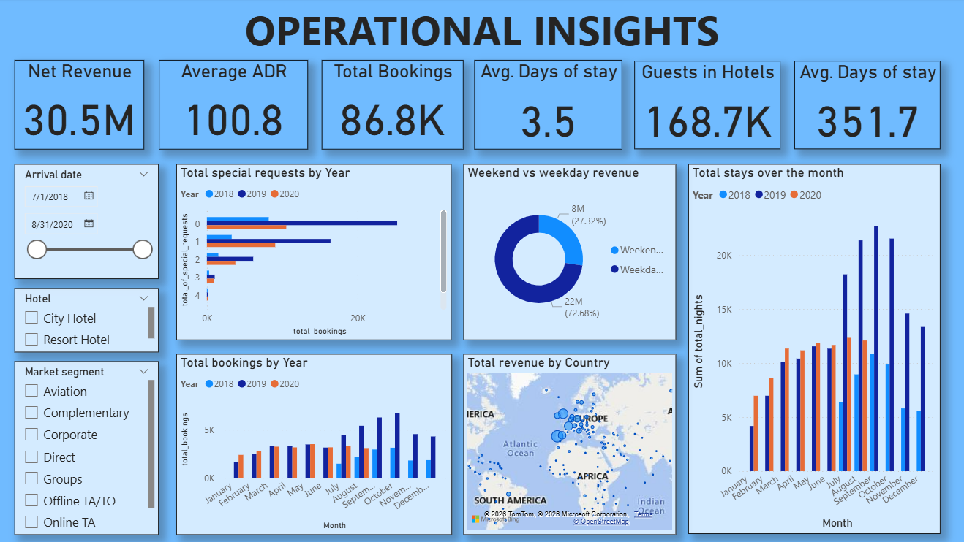
Dashboard 4: Operational Insights
Title: Operational Insights
This dashboard provides insights related to hotel operations.
Key visualizations include:
Stay Duration Distribution
Weekday vs Weekend Revenue
Impact of Special Requests
Occupancy by Month
Top Countries by Bookings (Map Visualization)
These insights help hotels improve operational planning and
resource management.

Slide 14
Key Insights
The analysis revealed several important insights:
Travel agents contribute a large portion of bookings.
The cancellation rate is relatively high.
Most guests are new customers rather than repeat customers.
Seasonal trends significantly impact hotel revenue.
Certain room types generate higher revenue compared to others.
These insights help hotels improve marketing, pricing, and operational strategies.

Slide 15
Conclusion
This project demonstrates how data analytics and visualization can transform hotel booking data into valuable insights.
Through interactive dashboards, the analysis provides a clear understanding of:
Revenue performance
Customer booking behavior
Pricing strategies
Operational insights
These insights help hotel management make better strategic decisions and improve overall business performance.

